Slide 1
Android 02: Activities
David Meredith
dave@create.aau.dk

Slide 2
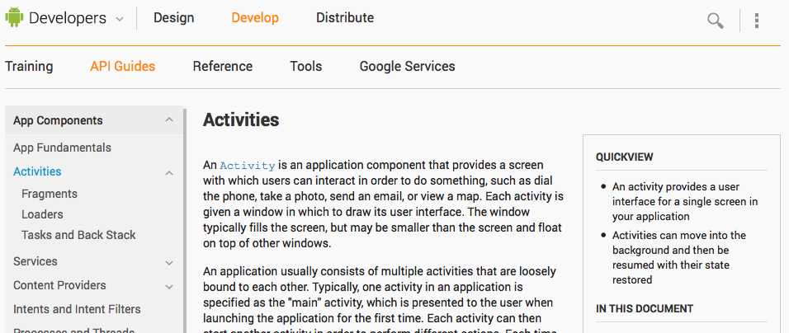
Source
http://developer.android.com/guide/components/Activities.html

Slide 3
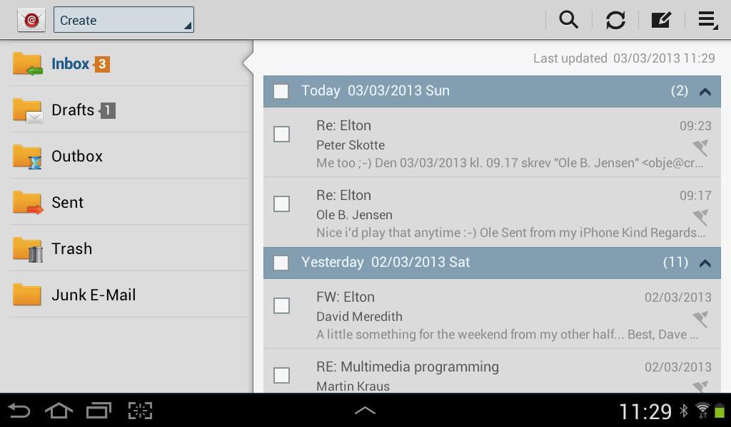
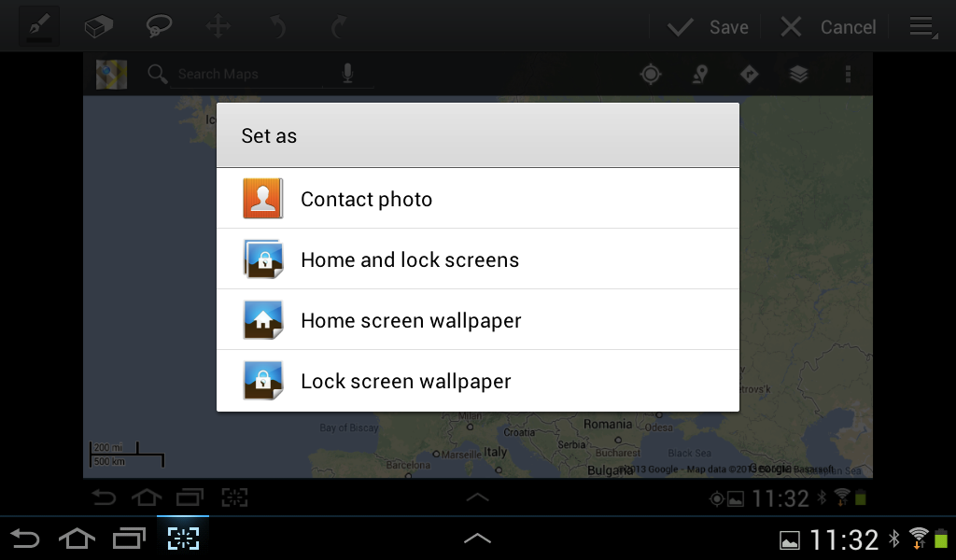
An Activity is a single screen
Activity is a component that provides a single screen with which the user can interact
e.g., dial the phone, send a mail, view a map
Activity has a window in which its interface is drawn
window may fill the screen or be smaller than the screen and float on top of other windows

Slide 4
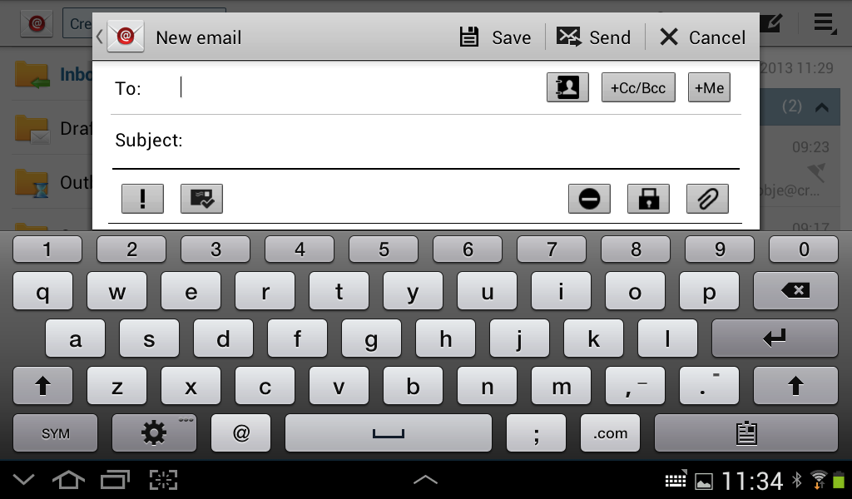
Multiple Activities
Application usually has several Activities that are loosely bound to each other
One Activity will be the “main” Activity
main Activity is presented when the program is launched
An Activity can start another Activity
When a new Activity starts
previous Activity is stopped or paused
new Activity placed on top of the “back stack”
new Activity takes focus

Slide 5
Back stack
Back stack is a LIFO stack
When user presses back button on the current Activity, this pops that Activity from the back stack, returning focus to the previous Activity (which is now again at the top of the back stack)

Slide 6
Pausing and resuming an Activity
onResume()
onPause()
When an Activity is stopped or paused because another Activity takes focus, system calls the Activity’s onPause() or onStop() methods
callback methods that you need to override
e.g., to release resources like database or network connections
When Activity is resumed (onResume()), you can reacquire resources that it needs to run

Slide 7
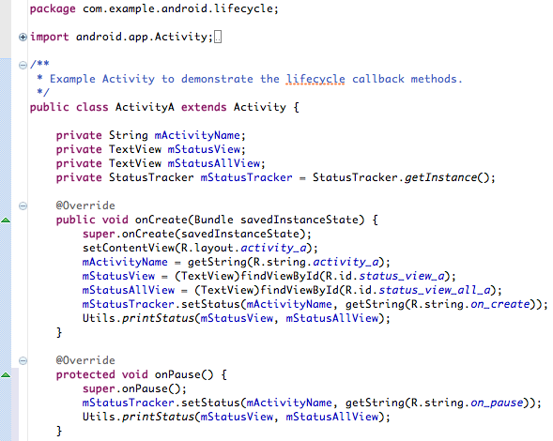
Creating an Activity
To create your own Activity, you must define or use a subclass of Activity
Need to override callback methods called when the Activity changes state, e.g.,
onCreate()
Called when Activity is created
need to call setContentView() to define interface layout
onPause()
Called when user leaves Activity
Need to commit changes that must persist beyond the current user session

Slide 8
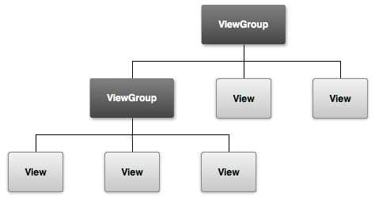
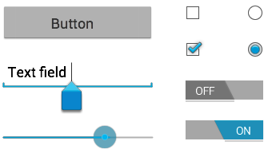
Implementing a user interface
UI is a hierarchy of View objects
Each View controls a rectangular space in the Activity’s window
may respond to user interaction
e.g., button that starts an action when touched
Widgets are ready-made Views
e.g., button, text field, checkbox, image
Layouts are ViewGroups (special type of View)
provide layout model for child views
e.g., linear layout, grid layout, relative layout
cf. LayoutManager objects in Swing

Slide 9
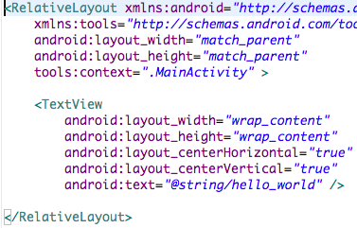
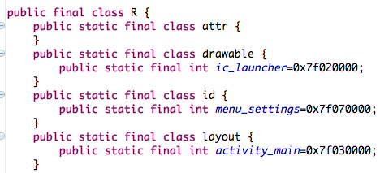
Defining a layout
Use an XML layout file saved in your application resources
Keeps interface appearance separate from code that defines behaviour
Use setContentView(int) to set the layout for your UI
pass the resource ID (defined in R.java) as an argument
Can also build Views and Layout in the Java code and pass the root ViewGroup to setContentView(View)

Slide 10
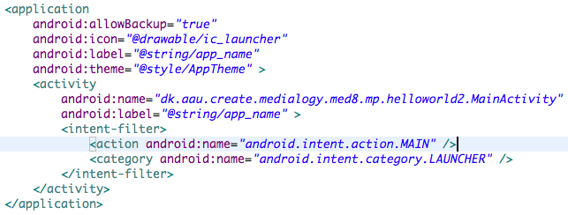
Declaring Activity in the manifest
Each Activity must be declared in the manifest file (AndroidManifest.xml)
Add an <activity> element as a child of the <application> element
Can also specify label, icon or theme here in the <activity> element
android:name attribute is only required attribute
Should not change this after you have published the app

Slide 11
Using intent filters
Use <intent-filter> element inside an <activity> element to specify intent filters
Default intent filter for stub activity created when you used SDK declares that activity
responds to “main” action
i.e., this is the “main” entry point to the app
should be placed in the “launcher” category
i.e., should be listed in system’s application launcher
Only one activity in your app should respond to main action and be in the launcher category
Activities that are not to be started by other applications don’t need intent filters
To start an activity with an implicit intent, need an <intent-filter> element containing <action> element and, optionally, <category> and <data> elements

Slide 12
Starting an Activity
Start another activity by calling
startActivity(Intent)
Intent either
specifies an Activity class (explicit)
specifies an action (implicit)
OS finds an appropriate Activity whose intent filter matches the action
Activity may even be in another application!
Intent may carry small amounts of data to be used by started Activity

Slide 13
Explicit intent
If you want to call an Activity that is already defined in your app, then use an explicit intent that specifies the exact class of the Activity to be started

Slide 14
Implicit intent
You may need to carry out an action that cannot be executed using an Activity from your own app
e.g., send an email, take a photo, get a status update
To do this, you send an implicit intent that only
specifies the action to be performed
provides any data that the called Activity requires

Slide 15
Implicit intents
OS selects Activity to carry out intent, may give user a choice if there is more than one such Activity available
In example above, Intent.EXTRA_EMAIL indicates that recipientArray is an array of Strings to be used as email addresses to be placed in the “To:” field of the email
Once email send Activity has finished, popped from back stack and focus returns to the Activity that started it

Slide 16
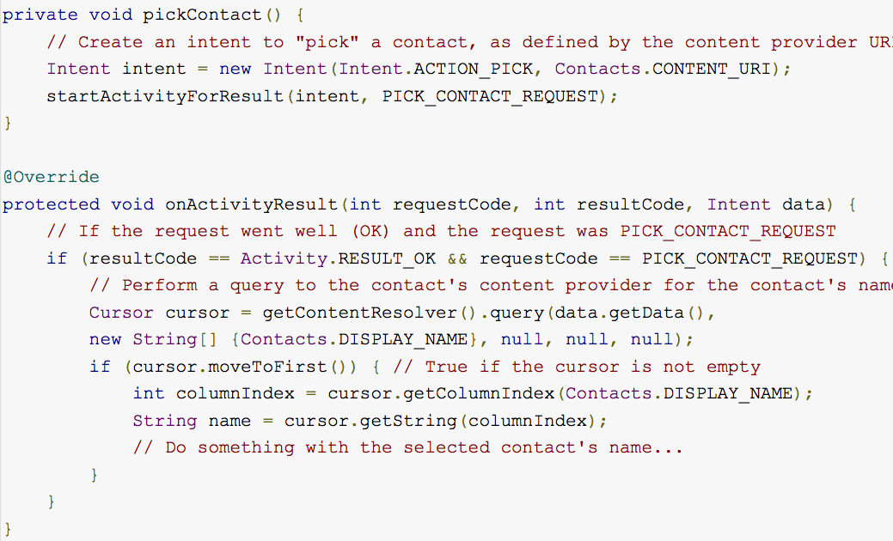
Starting an Activity for a result
Use startActivityForResult() to obtain a result from the Activity that you start
Then implement onActivityResult() to carry out some action in response to the result from the Activity
The result from the started Activity is returned in an Intent which is automatically given in an argument to onActivityResult()

Slide 17
An example
Sends an Intent to the Contacts database that lets the user pick a contact
Contact data returned in an Intent passed to onActivityResult()
Checks resultCode is Activity.RESULT_OK
Checks that requestCode is the same as that used to start the Activity
Uses a ContentResolver to query a ContentProvider and get a Cursor which is used to get the required data from that returned in the Intent

Slide 18
Shutting down an Activity
You can shut down an Activity by calling its finish() method
You can shut down another Activity that you previously started by calling finishActivity(Activity)
You should generally NOT explicitly finish activities using these methods
Let Android manage Activity life-cycles for you!

Slide 19
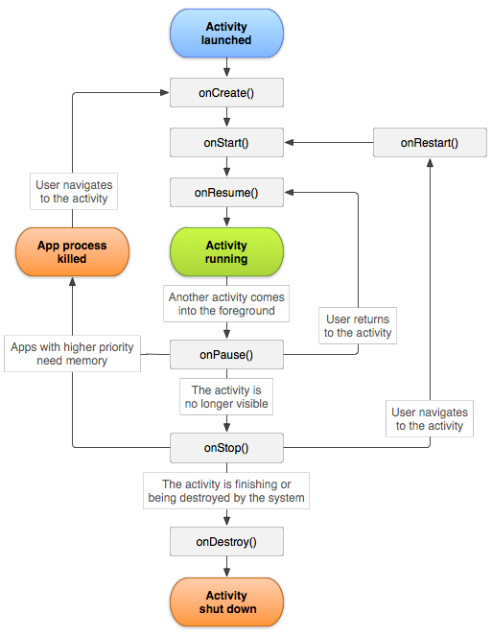
Managing the Activity Lifecycle
Activity can exist in three states
Resumed
Activity in foreground of screen with user focus (i.e., “running”)
Paused
Another Activity is in the foreground and has focus
This Activity is still partially visible
This Activity is still in memory and attached to window manager
Can be killed by system if resources need freeing up
Stopped
This Activity is in the background and invisible
Activity still in memory but NOT attached to a window manager
Can be killed by system if resources needed elsewhere
System can finish or kill Activity if paused or stopped

Slide 20
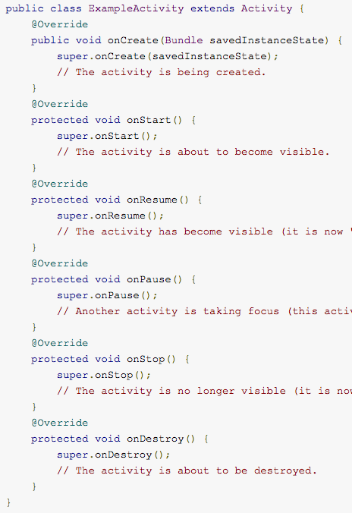
Implementing lifecycle callbacks
Main lifecycle callbacks are
onCreate() – when Activity is being created
onStart() – Activity is about to become visible
onResume() – Activity has become visible
onPause() – Another Activity is taking focus
onStop() – Activity is no longer visible
onDestroy() – Activity is about to be destroyed
You override these for your own Activities
Your implementation of a lifecycle callback should always start by calling the superclass implementation
The Activity lifecycle consists of three nested loops
The entire lifetime
The visible lifetime
The foreground lifetime

Slide 21
Entire lifetime
Entire lifetime of an Activity extends from onCreate() to onDestroy()
onCreate() should set up global state
e.g., defining layout
onDestroy() should release all resources
e.g., thread running in background downloading data should be stopped
If the Activity is restarted after being destroyed, it has to be created again

Slide 22
Visible lifetime
Visible lifetime extends from onStart() to onStop()
User can see and interact with Activity during its visible lifetime
onStop() is called when a new Activity starts and makes this one invisible
should close down resources that are not needed while the Activity is invisible
should store any data that needs to persist to the next user session – in case Activity is destroyed before it is resumed

Slide 23
Foreground lifetime
Foreground lifetime extends between onResume() and onPause()
During this period, Activity has user focus and is in front of any other visible Activities
onPause() called, e.g., when device goes to sleep or a dialog appears
can happen often, so onPause() and onResume() should not be computationally expensive or time-consuming

Slide 24
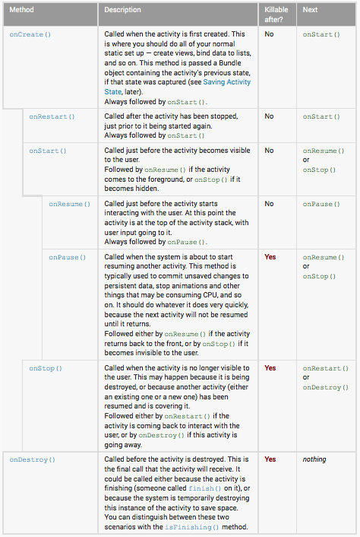
“Killability”
System can kill Activity after onPause(), onStop() or onDestroy()
onPause() is the last method guaranteed to be called before the Activity is killed
So write crucial data in onPause() in case process is killed after it completes
But do not cause program to block for too long!

Slide 25
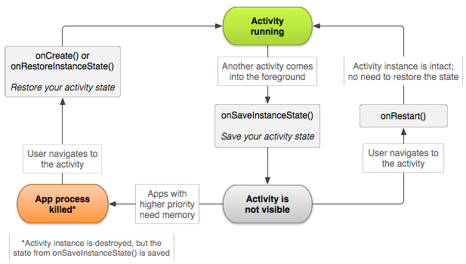
Saving Activity state
When paused or stopped, Activity is still in memory, so state of Activity is retained
changes made by the user are still there when Activity resumes
If Activity is destroyed by the system, then erased from memory and must be recreated if user navigates back to it
State of Activity not retained unless saved before destroying
Do this by overriding onSaveInstanceState()

Slide 26
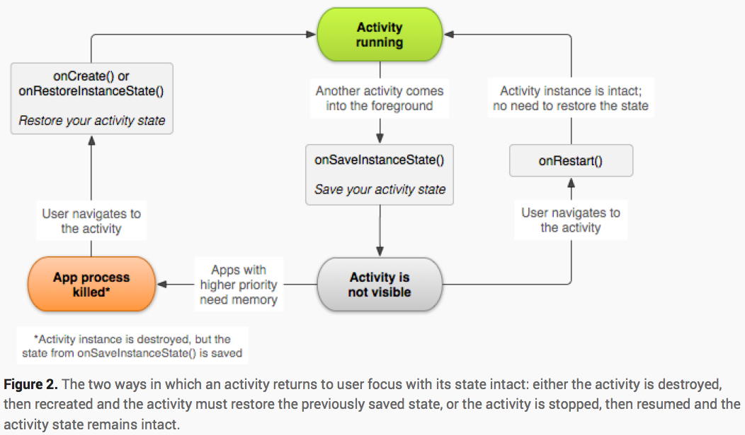
onSaveInstanceState()
onSaveInstanceState(Bundle outState) called just before system destroys Activity
State of the Activity is stored in the outState Bundle as a set of name-value pairs
using, e.g., putString(), putInt(), etc.
If Activity re-created then outState Bundle passed to onCreate() or onRestoreInstanceState() which read the state from the Bundle and restore the UI

Slide 27
onSaveInstanceState()
No guarantee that onSaveInstanceState() will be called before your Activity is destroyed
e.g., if user leaves Activity using back button or explicitly closes the Activity
If system calls onSaveInstanceState(), does so before onStop() or onPause()
Some state is stored anyway by default implementation of onSaveInstanceState()
states of most Widgets and Views in UI are stored by default
must provide an ID for each widget that you want saved

Slide 28
Saving Activity state
Default implementation of onSaveInstanceState() does not save member values that you define
Always call the superclass’s method at the beginning of your implementation of onSaveInstanceState()!
Also call superclass method for onRestoreInstanceState() if you override it
Use onPause() to store persistent data – onSaveInstanceState() is not guaranteed to be called
Can check ability to restore state by rotating device
Activity destroyed and re-created when device rotated!

Slide 29
Handling configuration changes
Some configuration changes cause Activity to be destroyed and re-created
e.g., screen orientation, keyboard availability, language
Allows Activity to change resources to suit new configuration
Use onSaveInstanceState() and onRestoreInstanceState() or onCreate() to handle such configuration changes

Slide 30
Coordinating Activities
A | B
onPause()
 | onCreate()
 | onStart()
 | onResume()
onStop() [if not visible]
Suppose Activity B is started by Activity A
Table shows order in which callbacks are called
So if you want Activity B to read from a database that has been used by A, then make sure A writes to the database in its onPause() method, not its onStop() method

